Slide 1
TK2100: Informasjonssikkerhet Lesson 02: Cryptography
Dr. Andrea Arcuri
Westerdals Oslo ACT
University of Luxembourg

Slide 2
Goals
Understand the basics of cryptography and crypto analysis
Knowledge of the most common crypto algorithms, and when/where they should be used
Crypto is heavily based on MATH… but we will not dig into too many details…
Revision of HTML/CSS/JS
Needed for exercises, and rest of the course

Slide 3
Cryptography
Practice and study of technique for secure communication, even in the presence of adversary listeners
Why? Communication from you computer to a server (eg, on Internet) goes through many routers in different countries
Anyone having access to these routers can read your messages
You would like your Internet Banking and access to email to be protected…

Slide 4
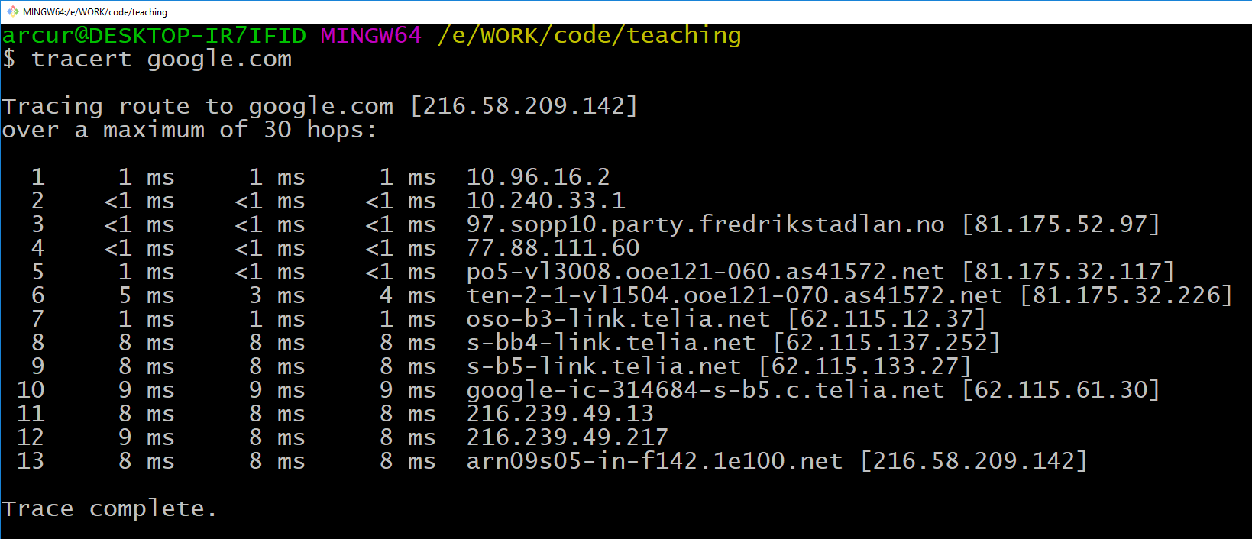
13 machines from Fjerdingen to google.com

Slide 5
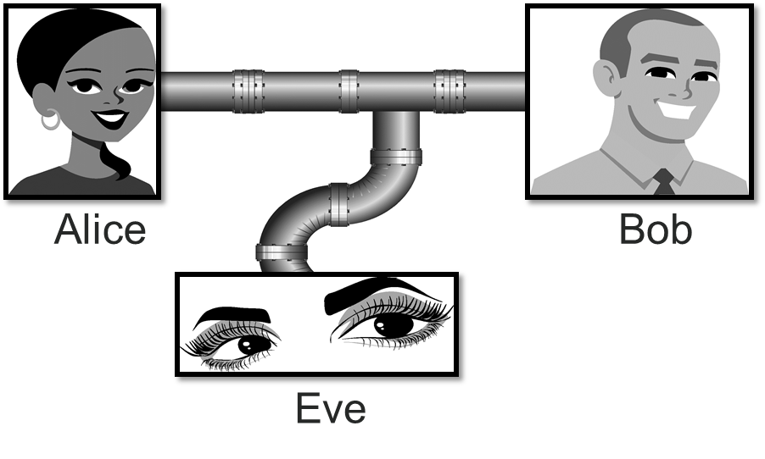
Even if Eve can intercept messages between Alice and Bob, she should not be able to understand them
Note: Alice, Bob and Eve are typical names in security examples

Slide 6
Encrypt/Decrypt
Scenario: Alice wants to send message T to Bob
Alice encrypt T using an encryption algorithm e() with a secret S, ie e(T,S)=C, where the resulting C is called ciphertext
Bob receives encrypted C, and decrypt it using d() and secret S’, ie d(C,S’) = T
Note: we will see some cases when S != S’
e(T,S)
d(C,S’)
T
C
T
Alice
Bob

Slide 7
Why is it secure???
Even if Eve can intercept the ciphertext C, and knows all the details of the algorithms e() and d(), she should NOT be able to decrypt the original message
Ie, only by knowing S’ one should derive d(C,S’)=T
S’ can be just a small text, eg like a password
But how can we write algorithms e() and d() to ensure it?
e() and d() are usually called ciphers
During history, many different algorithms proposed
Problem: what seems secure today can get broken tomorrow…

Slide 8
Substitution Cipher

Slide 9
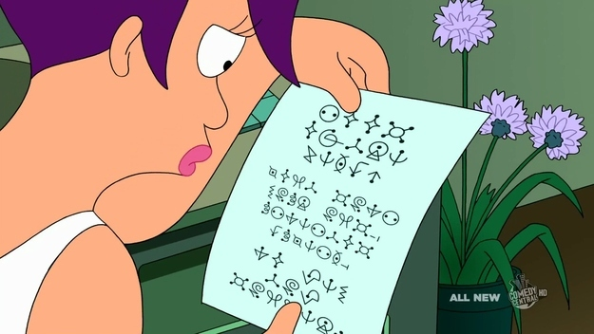
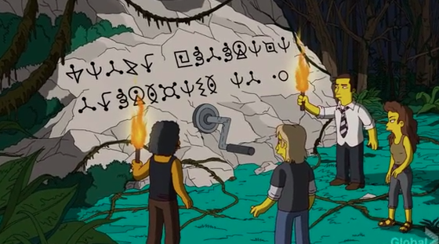
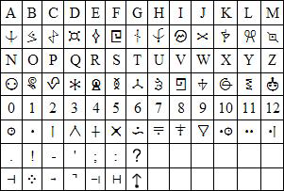
Futurama Alien Language
Each symbol is actually representing a letter
1-to-1 mapping from letter to Alien symbol
Text on the right says: “WATCH FUTURAMA THURSDAYS AT 10”

Slide 10
Ciphers during Roman Empire
Communications to generals in the army should be kept secret
Even if messages get caught by the enemy
Do not need to invent special symbols, but just mapping from a letter to another

Slide 11
Mapping in Code
Before digging into it, need to recall how characters are stored in a computer
As for any data, a character is a 0/1 binary sequence
A character can be seen as a number
Different mappings from numbers to characters to display, called charsets
Different charsets, but we ll just focus here on ASCII
You will see more on this next semester, eg in Algorithms course, like UTF-8

Slide 13
ASCII 1967
7 bits per char, so 2^7=128 chars
Latin letters and symbols (no Norwegian øæåØÆÅ)
for Norwegian you need other encodings like UTF-8…
0-31 and 127 are control characters, non-printable
many, but not all, are just there for historical reasons, and not really used any more
Upper and lower case letters use different codes
a=97 whereas A=65

Slide 14
Substitution in Code
c’ = c + s
Where “s” is just a constant, and will be your “secret” in this cipher (also called key)
Example, if s==7, then letter “Z” (90) turns into an “a” (97)
Slightly tricky: you need to use module “%” to avoid the sum going over 127, and also need to avoid control 0-32 and 127 values
Note: implementing this will be one of the exercises…

Slide 15
Secret
The added constant “s” (eg 7) is going to be the “secret” you would share before communication
But how “secure” is such cipher?
You could brute force substitutions from s=1 to s=128, and check against a dictionary for word matches
Trivial to break with a PC

Slide 16
Generic Mapping
Each letter directly mapped to another letter
Can be implemented with an array
But is it better than c’=c+s???
A | B | C | D | E | F | G | H | I | J | K | …
W | C | P | T | E | J | Z | A | U | M | B | …

Slide 17
Combinations
To keep it simple, let’s just consider the 26 English letters
26 different ways to map “A” to another letter
Once “A” mapping is chosen, cannot be reused, and so left 25 options for “B”
Once “B” (and “A”) are chosen, 24 options for “C”
and so on, until only 1 option for “Z” when all other letters are already mapped
So, 26*25*24*23…*3*2*1 = 26! =~ 4*10^26
“Secret” to share: 26 letter mapping, whereas before was just a number

Slide 18
Polygraphic Substitution Ciphers
10^26 is a lot, but could do more
Instead of mapping single letter, could do mapping of blocks of letters, eg by 2
There are 26*26=676 pairs of letters
So, factorial 676! combinations, which is HUGE
Negative side: now “secret” to share is 676 pair mapping…
Could even consider more than 2 letters at a time, ie blocks of m letters
eg, Vigenere Cipher, 1586, we will see in the next slides
Again, is it secure???
AA | AB | AC | AD | AE | AF | AG | AH | AI | AJ | AK | …
BW | CA | PR | TT | JE | JD | ZY | AB | UY | RM | KB | …

Slide 19
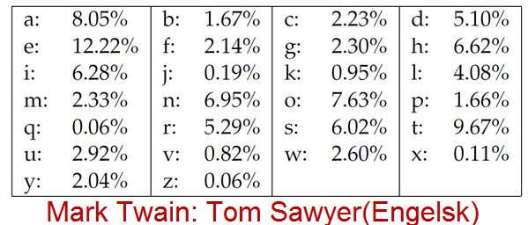
Nope… not secure at all…
Substitution ciphers do NOT hide the frequency of the characters
Some characters are used more often, and the mapped ones will appear as often in the ciphertexts
Those frequency values can be computer from existing corpora, eg books, dictionaries and magazines
Eg, the most common used letter in English is “e”
Can analyze frequency of letters in ciphertext to infer the used secret, ie mapping
Note: this assumes knowledge of type of message (eg text and language vs other kind of data, eg images)

Slide 20
One-Time Pads

Slide 21
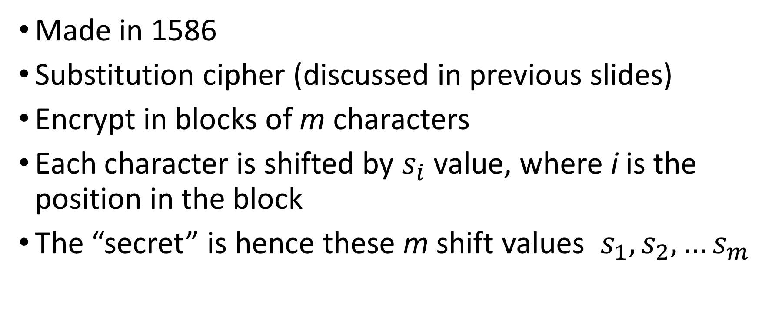
Vigenere Cipher
Made in 1586
Substitution cipher (discussed in previous slides)
Encrypt in blocks of m characters
Each character is shifted by $s_{i}$ value, where i is the position in the block
The “secret” is hence these m shift values $s_{1},s_{2},…s_{m}$

Slide 22
Vigenere Example
S = {5, 2, 1}, m=3, text = “Hello”
H | e | l | l | o
72 | 101 | 108 | 108 | 111
+5
+2
+1
+5
+2
M | g | m | q | q
77 | 103 | 109 | 113 | 113

Slide 23
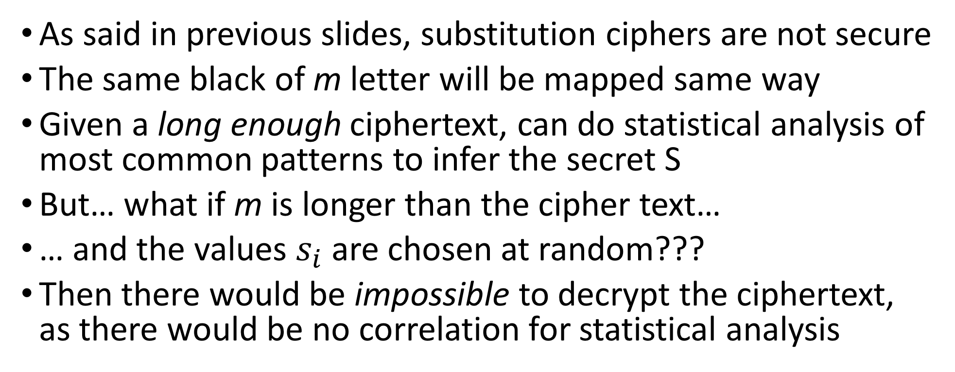
One-Time Pads
As said in previous slides, substitution ciphers are not secure
The same black of m letter will be mapped same way
Given a long enough ciphertext, can do statistical analysis of most common patterns to infer the secret S
But… what if m is longer than the cipher text…
… and the values $s_{i}$ are chosen at random???
Then there would be impossible to decrypt the ciphertext, as there would be no correlation for statistical analysis

Slide 24
Sharing of Secrets
With base Vigenere Cipher, need first to share a secret of length m (eg 10 values), and then can encrypt/decrypt as long text as I want, for how many times I want
Eg, a whole book
With One-Time pad (ie Vigenere with long random S), the length of the secret is equal or more than the ciphertext
Encrypting a book would require a S that is as long as the book
Is securely sharing a long secret S practical???

Slide 25
Can first share (long) S when in secure context, and then afterwards use it as One-Time Pad when requiring secure communications

Slide 26
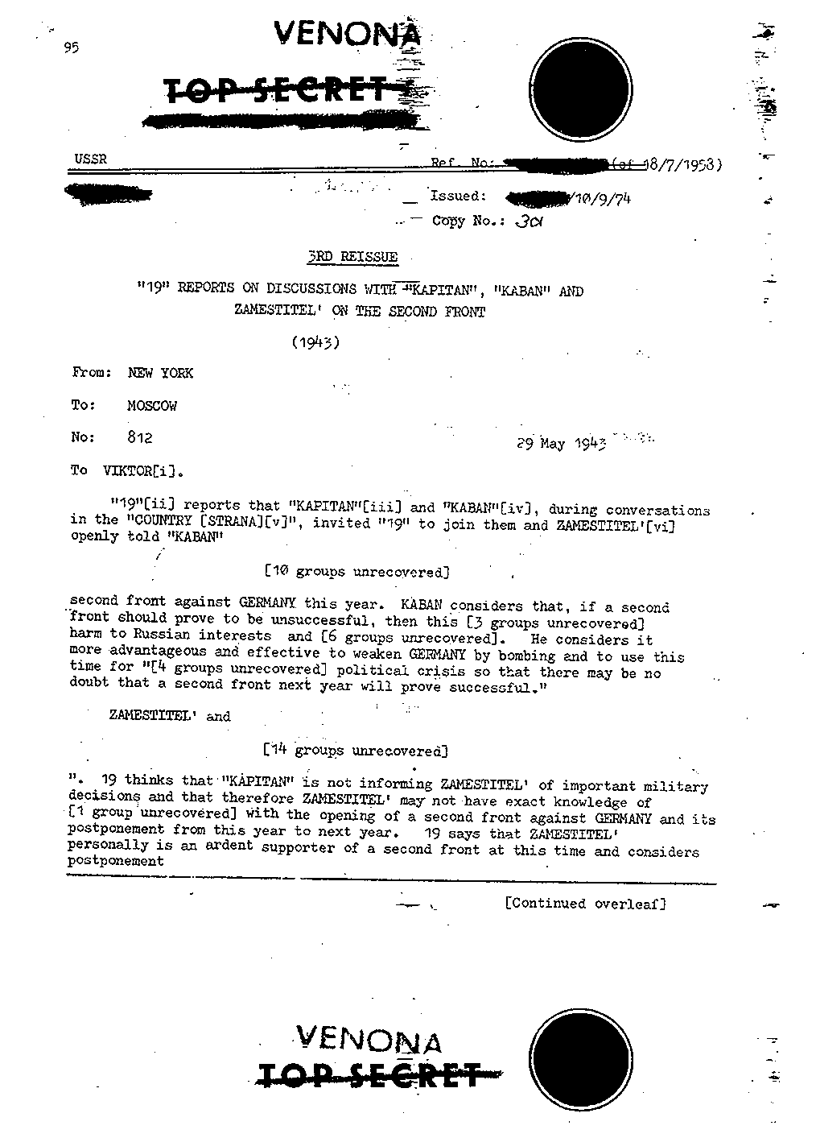
Cold War 1962-1979
One-Time Pads were used by spies during the Cold War between USSR and USA
Problem: once a spy used the whole S for his communications, could not get a new one (eg, when infiltrated in an enemy country)… so started to re-use it…
… but when re-using it, it is exactly like Vigenere, so can be statistically analysed and broken
Ie, One-Time Pad is secure only as long as secret S is not re-used

Slide 27
Binary One-Time Pads
So far we have been talking of written text
But might need to encrypt any kind of data (eg images)
So, we need to generalize to 0/1 bit strings
But, let’s talk of XOR first…

Slide 28
Exclusive-or (XOR)
XOR | 0 | 1
0 | 0 | 1
1 | 1 | 0
Bit operation: takes 2 bits, gives 1 as output
Result 0: if the bits are equal
0 xor 0 = 0
1 xor 1 = 0
Result 1: if the bits are different
0 xor 1 = 1
1 xor 0 = 1
For bit strings, xor one bit at a time
eg, 10100 xor 01101 = 11001
Highly efficient operation
A | 1 | 0 | 1 | 0 | 0
B | 0 | 1 | 1 | 0 | 1
XOR | 1 | 1 | 0 | 0 | 1

Slide 29
Binary One-Time Pads: Cont.
Message M as binary 0/1 string
Secret P (pad) being a random binary string
Ciphertext simply: C = M xor P
Recover message: M = C xor P
Highly efficient to compute, can be applied to any kind of data

Slide 30
Advanced Encryption Standard (AES)

Slide 31
Advanced Encryption Standard (AES)
One-Time Pads are secure as long as the pad is not re-used
So, not too practical for current security needs
AES (1997) is current best approach for symmetric encryption
Symmetric: both sender and receiver use the same key/secret
ie, S=S’
3 different versions: 128, 192 and 256 bits
tradeoff between security and efficiency of the algorithms
ie, more secure version (256) takes longer to compute

Slide 32
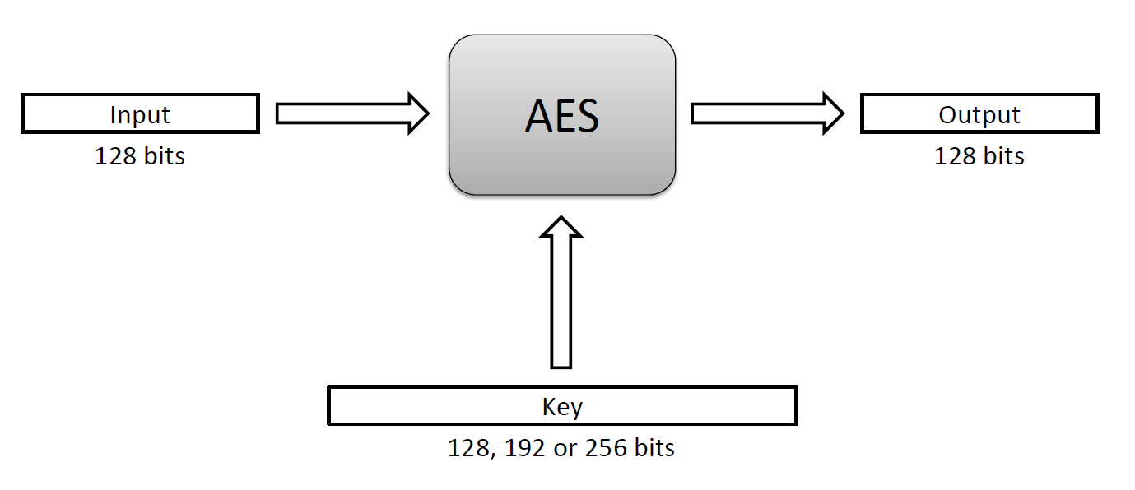
Blocks
AES encrypts/decrypts a message in blocks of 128 bits
But how does it works internally?

Slide 33
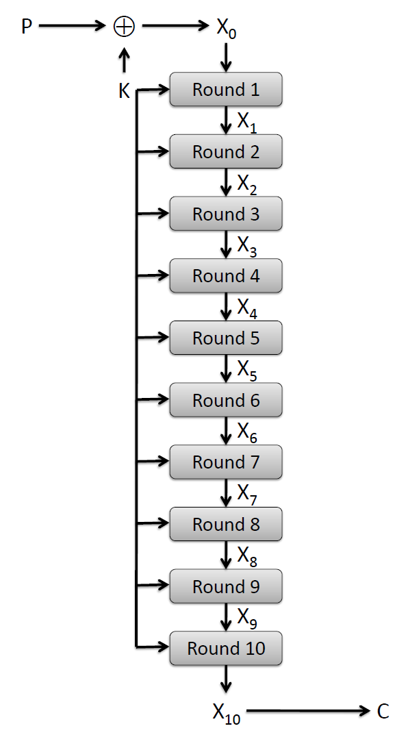
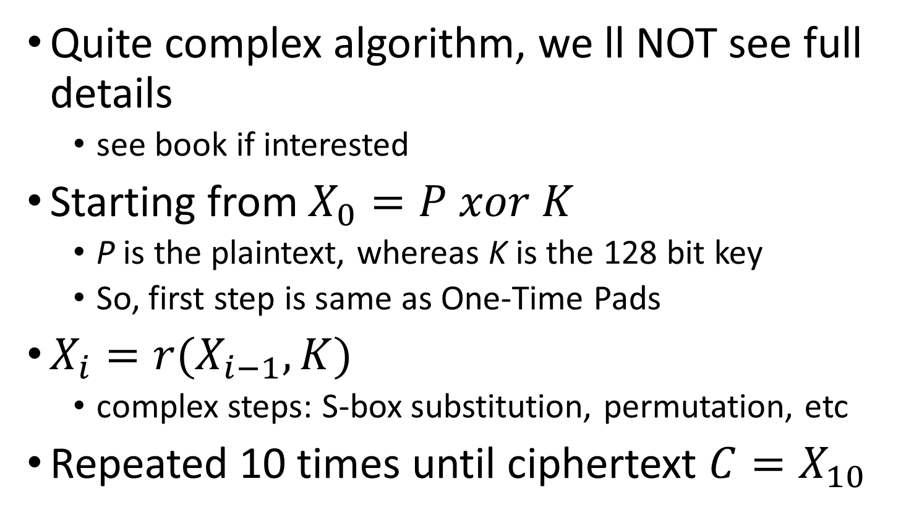
128 Bit Version
Quite complex algorithm, we ll NOT see full details
see book if interested
Starting from $X_{0}=P xor K$
P is the plaintext, whereas K is the 128 bit key
So, first step is same as One-Time Pads
$X_{i}=r(X_{i−1}, K)$
complex steps: S-box substitution, permutation, etc
Repeated 10 times until ciphertext $C=X_{10}$

Slide 34
AES Security
AES is highly secure, especially the 256 bit version
Not possible to brute force it with current hardware/systems
In contrast to One-Time Pads, the secret/key can be reused
But how can Alice and Bob share a 256 bit key secretly if they do not know each other?
Eg, if you want to communicate securely with different web sites (your bank, Facebook, etc.), how to share the secret key?
With symmetric keys, you can’t do it directly…

Slide 35
Public-Key Cryptography

Slide 36
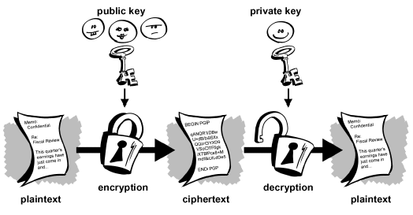
Asymmetric Keys
The key K used for encryption is different from the K’ used for decryption
So, need at least 2 keys
Why? Can publicly share the encryption key K, but then keep private the decryption K’ one

Slide 37
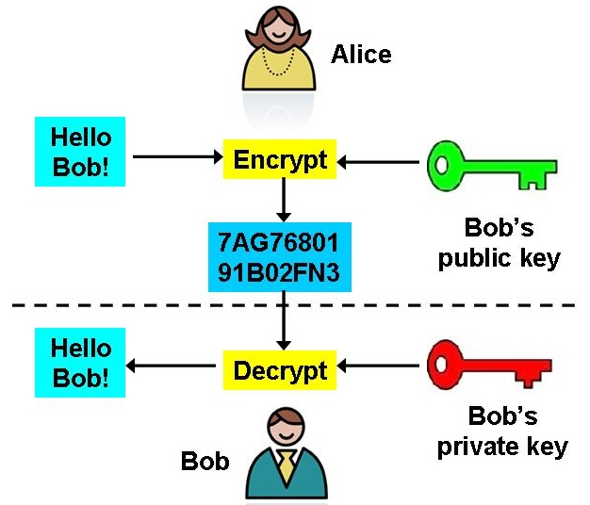
Public/Private Keys
Each user will have 2 keys: one private, and one public
When Alice wants to speak with Bob, it will be encrypt with the public key of Bob
Only Bob can decrypt the ciphertext using his private key
When replying, Bob will use Alice’s public key, and so on

Slide 38
Why does it work?
Alice and Bob do publicize and share their public keys in the open
But how can we ensure that, even if Eve intercepts the encrypted messages, she cannot brute force and decrypt them even without Bob’s private key?

Slide 39
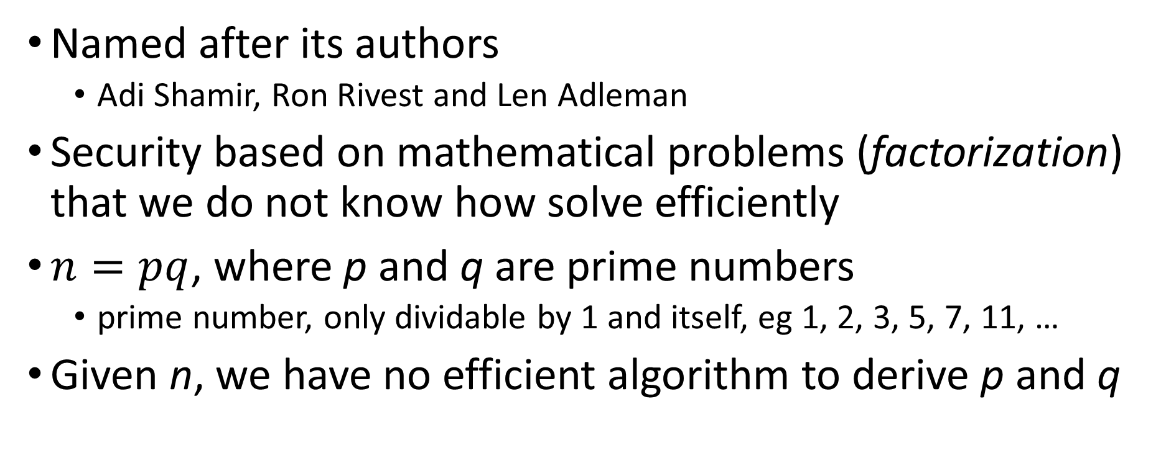
RSA Cryptosystem
Named after its authors
Adi Shamir, Ron Rivest and Len Adleman
Security based on mathematical problems (factorization) that we do not know how solve efficiently
$n=pq$, where p and q are prime numbers
prime number, only dividable by 1 and itself, eg 1, 2, 3, 5, 7, 11, …
Given n, we have no efficient algorithm to derive p and q

Slide 40
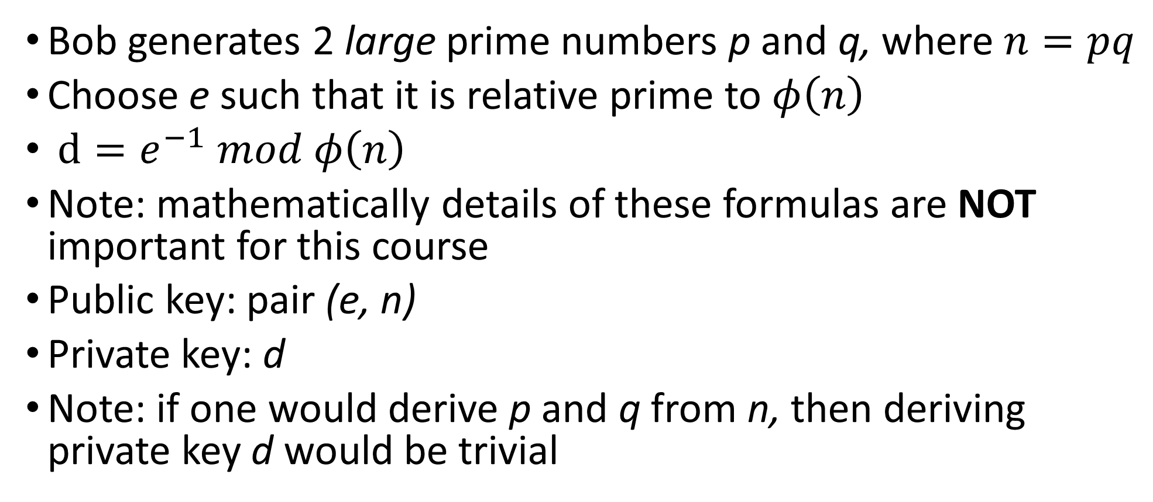
RSA Cont.
Bob generates 2 large prime numbers p and q, where $n=pq$
Choose e such that it is relative prime to $φ\left(n\right)$
$d=e^{−1} mod φ\left(n\right)$
Note: mathematically details of these formulas are NOT important for this course
Public key: pair (e, n)
Private key: d
Note: if one would derive p and q from n, then deriving private key d would be trivial

Slide 41
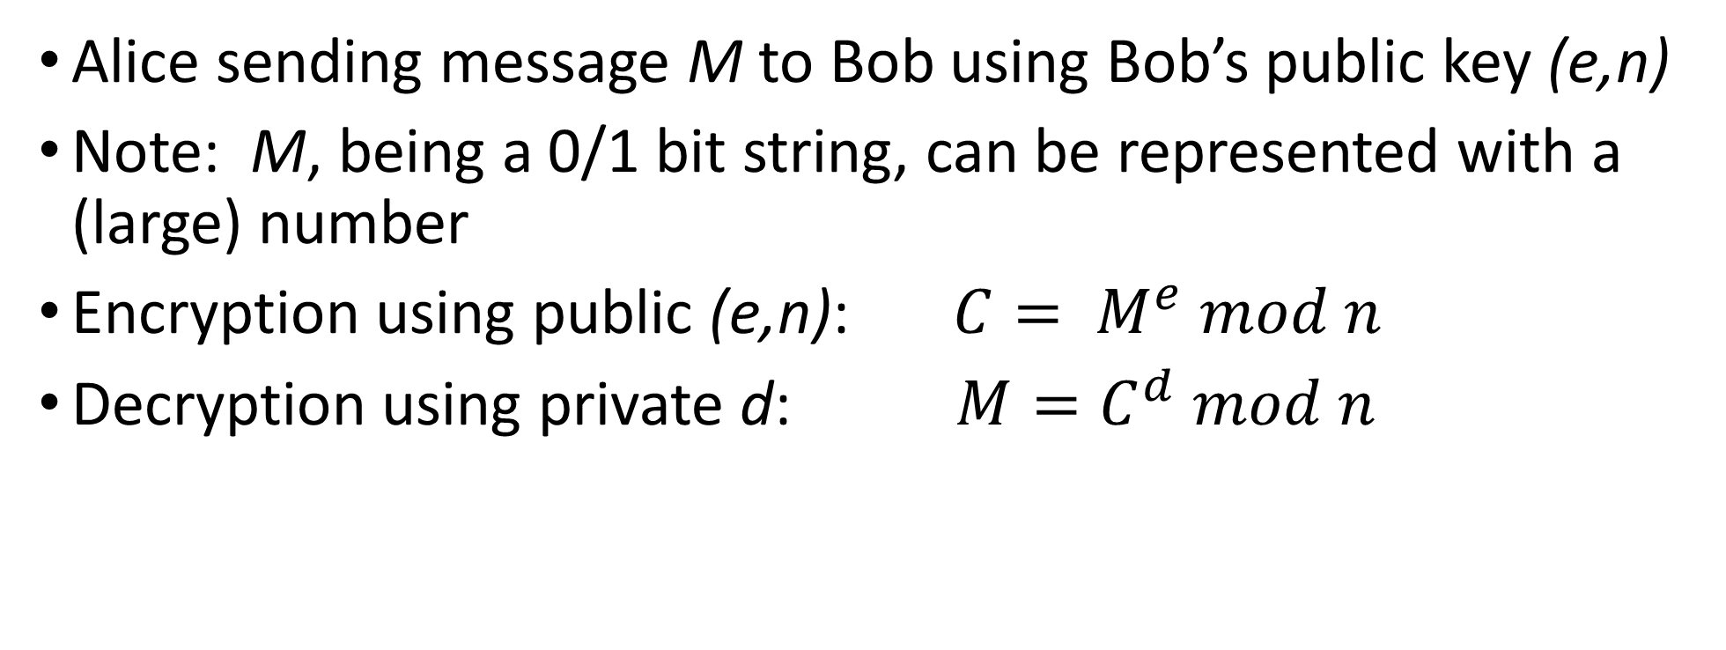
RSA Encryption/Decryption
Alice sending message M to Bob using Bob’s public key (e,n)
Note: M, being a 0/1 bit string, can be represented with a (large) number
Encryption using public (e,n): $C= M^{e} mod n$
Decryption using private d: $M=C^{d} mod n$

Slide 42
RSA Problem
Factorization (ie deriving p and q from n) is a hard problem, but can be brute forced if n is not too large
Currently, to be secure, recommended to use n with at least 2048 bits, which is a HUGE number
Problem: because RSA works on very large numbers, it is slow, much, much slower than AES
So, not efficient when needing to send many encrypted messages

Slide 43
Key Exchange: RSA + AES
In AES we have the problem of securely share the symmetric key
In RSA, we don’t have such issue, as public keys can be shared in the open
But RSA is very slow
RSA + AES: using RSA in the first step to share an AES key, and then keep communicating by using AES
Create AES key K
Alice
Send K with RSA
Alice
Bob
Use AES
Alice
Bob

Slide 44
HTTPS: SSL/TLS
When you access websites using HTTPS, those exchanges of messages/files are encrypted
Usually using RSA under the hoods
Certificate: the public key for the site you want to access (eg Facebook)
Certificate Authority: handling of certificates for the different web sites
Will go back on this when doing web security later in the course

Slide 45
HTML + CSS + JavaScript

Slide 46
Overlap With Other Courses
This course is about Information Security, not programming
But to understand security, you need to know how programming works
Studying just theory is not the same as doing some actual hacking
Later in the course there is going to be a focus on web, so need to understand the bases of web development
Although this is not a course on web development, we will go through it, even though the details will / should had been covered in other courses…
Think about it as a repetition…
However, the (3-h written) exam will be “theoretical”, and I will NOT ask you to write code (although I might show you code, and ask you questions about it)

Slide 47
HTML (HyperText Markup Language)
A markup language, not a programming one
Composed by tags, eg <body>, <p>, <a>, etc
When a browser receives a HTML file, it will parse its content, and create a GUI based on those tags
Most HTML pages do have references to other files, like for example images
Before a page is fully displayed in browser, those other files need to be downloaded

Slide 48
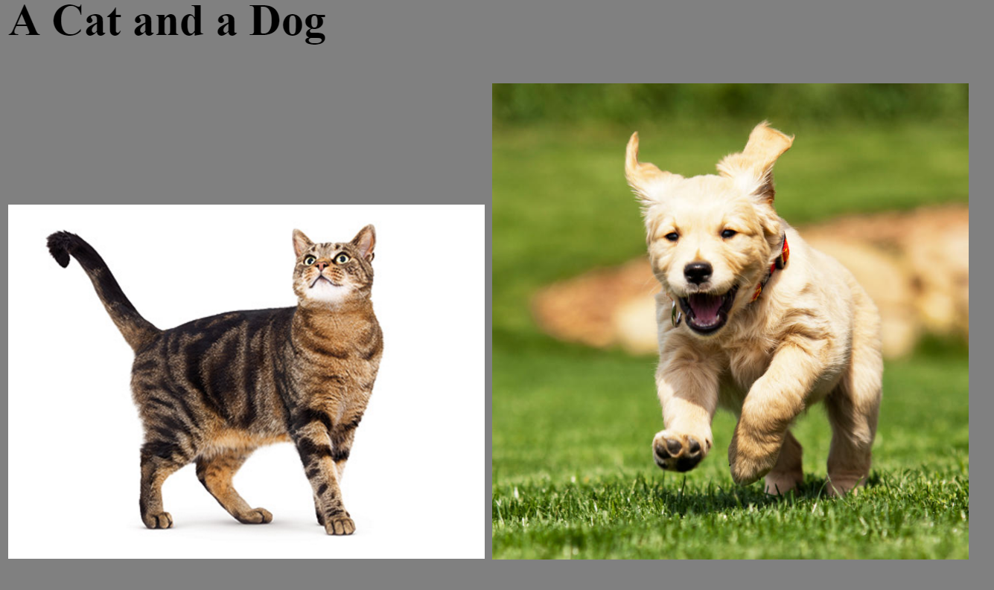

Slide 49
<HTML>
<HEAD>
<TITLE>Example</TITLE>
</HEAD>
<BODY BGCOLOR="gray">
<h2> A Cat and a Dog </h2>
<DIV>
<IMG SRC="figs/cat.jpg" style="width:256px">
<IMG SRC="figs/dog.jpg" style="width:256px">
</DIV>
</BODY>
</HTML>

Slide 50
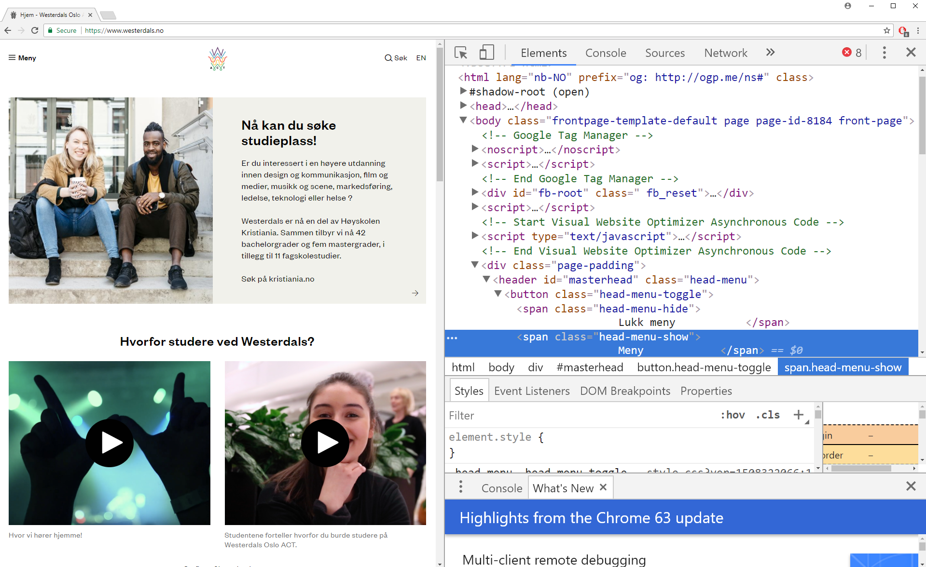
Chrome -> More tools -> Developer tools

Slide 51
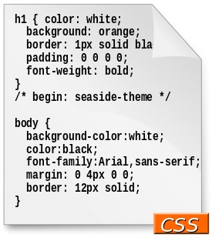
CSS (Cascading Style Sheets)
Language used to specify how the different HTML components should be displayed
Needed to specify for example: layout, colors and fonts
Can be embedded directly in HTML pages (eg, in the header)
However, often in separated files
for separation of document content from document presentation

Slide 52
JavaScript
JavaScript (JS) has nothing to do with Java
Programming language executed in the browser
JS code referenced by webpages like any other resource (eg images and CSS files), or can be embedded directly in HTML
JS can manipulate the DOM (Document Object Model) to alter the webpages structure/content based on user’s interactions (eg mouse clicks)

Slide 53
JavaScript is King on the Browser
If web page needs to execute code on browser, you use JS
But historically there were other options in the (not so long ago) past:
Java with Java Applets (practically dead)
Flash (still found in some old web pages)
Silverligth
Etc.
Those were not natively supported by browser, and you had to install plugins to run them

Slide 54
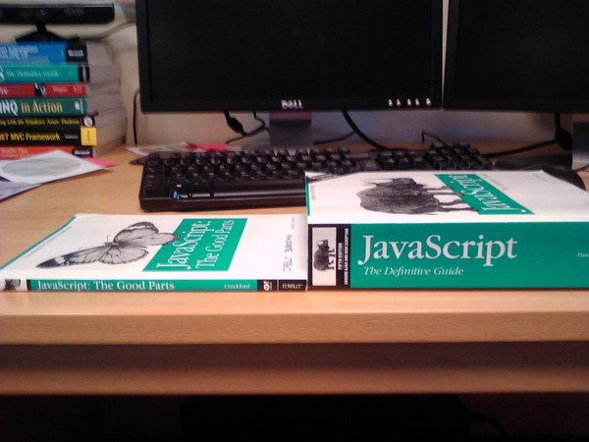
But JavaScript is a badly designed language…
When the most famous book is called “The Good Parts”, that tells you something…
However, there are other languages that do transpile to JS, like TypeScript and Kotlin
But configure them would be too complex at this point, and out of scope of this course…
… and WebAssembly might (hopefully) replace JS one day…
But we will need to write not so many lines of JS in this course, so you will survive…

Slide 55
Videos
https://www.destroyallsoftware.com/talks/wat
https://www.youtube.com/watch?v=EtoMN_xi-AM

Slide 56
DEMO
See lessons/02/html/lesson02_example.html in the Git repository
Note: this demo is not related to security, but it will be the starting point for this week exercise

Slide 57
For Next Week
Book pages: 25-30, 388-394, 399-400, 410-412
Note: when I tell you to study some specific pages in the book, it would be good if you also read the other pages in the same chapter at least once
Exercises for Lesson 02 on GitHub repository

